Slide 1

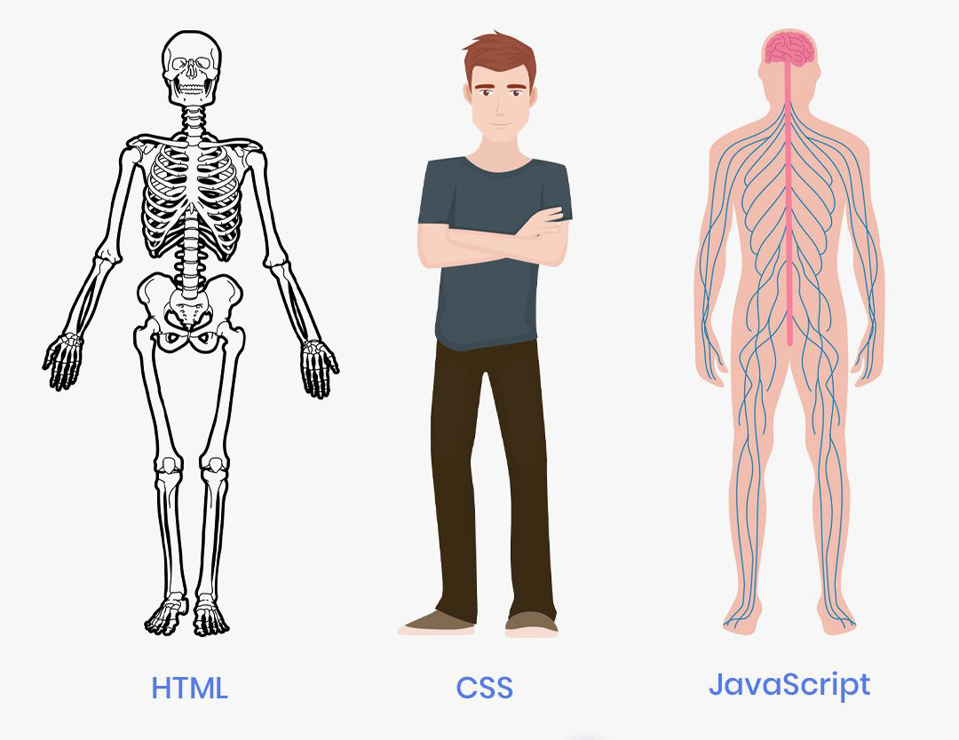
CSS
Cascading Style Sheet
Add
Style to the html tags,
Responsiveness to the website,
Animation and Transformation,

Slide 2
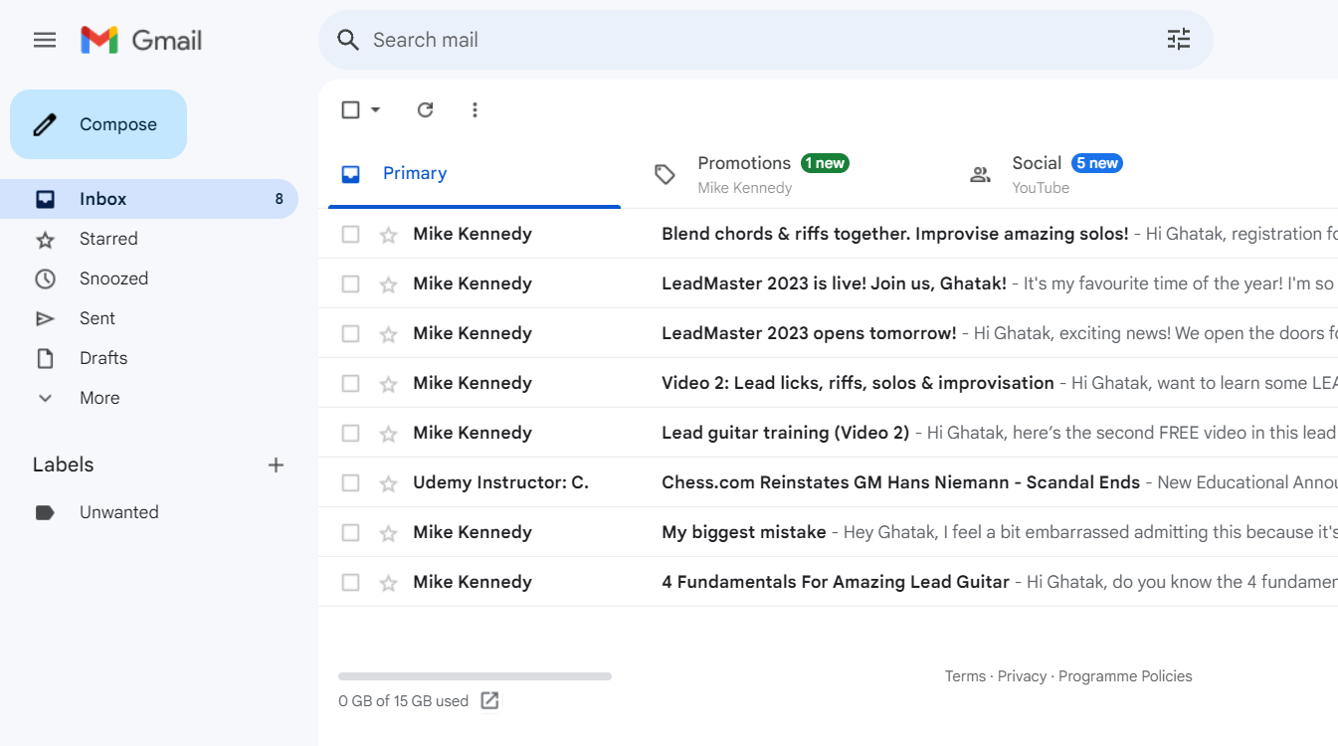


✅
✅

Slide 3
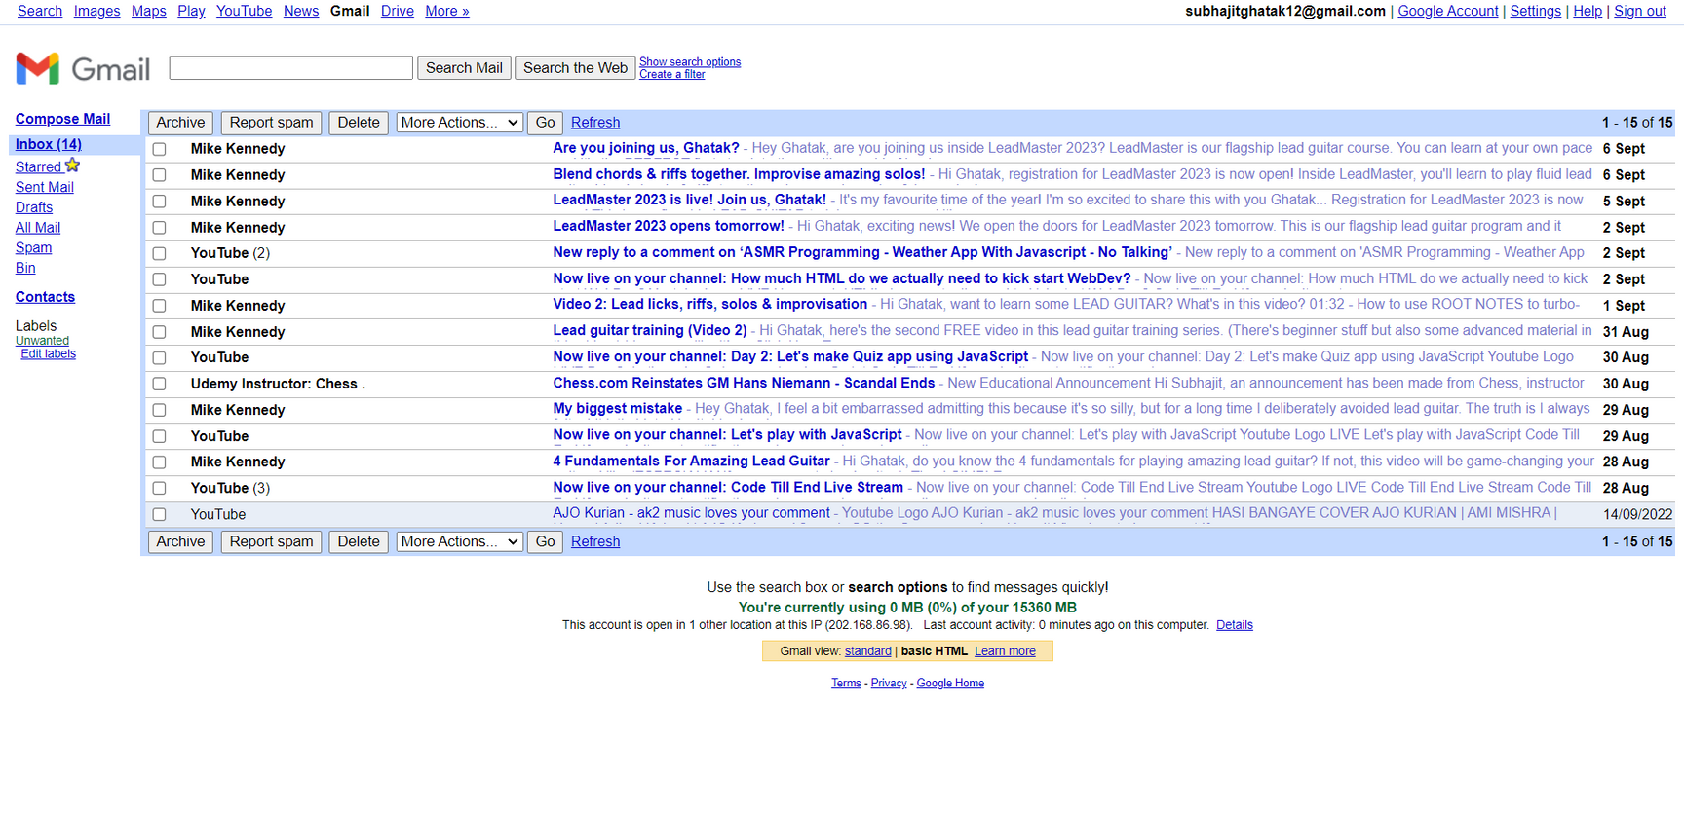
✅
❌

Slide 4
CSS Properties
Using properties we can write css.
Syntax:
property-name: value;
Example:
color: blue;

Slide 5

Margin vs. Padding
Margin: gap between element and browser window.
Padding: gap between element’s border and it’s content.

Slide 6
Relative vs. Absolute
Relative: Element try to position itself according to it’s original position.
Absolute: Element try to position itself according to it’s ancestor.

